Slide 1


What Machine Learning Is
01
PART I · FOUNDATIONS
CHAPTER 1 · WEEK 1
Machine Learning — From Hypotheses to Decisions
LECTURER
Dr. Mustafa Hameed
THE ISLAMIA UNIVERSITY OF BAHAWALPUR
Bahawalpur, Pakistan
Department of Information Technology · BSIT · Fall 2026
Notes:
Chapter 1: What Machine Learning Is. Part 1 — Foundations. Week 1: What machine learning is; its mathematics. Handout pages 3–10.

Slide 2

Where this chapter sits
THE COURSE
PART I
PART II
PART III
PART IV
PART V
PART VI
1
2
3
4
5
6
7
8
9
10
11
12
13
14
15
16
17
18
19
20
21
22
What Machine Learning Is
BUILDS ON
USED LATER IN
— nothing earlier in the course
Ch 2 Mathematics for Machine Learning
Ch 3 The Machine Learning Workflow and Toolkit
Ch 4 Concept Learning and the Version Space
Ch 20 Reinforcement Learning
Ch 22 The Machine Learning Project
Machine Learning · Chapter 1 · What Machine Learning Is
Handout p. 3 2
Notes:
Place the chapter. Before you start: The course Artificial Intelligence, in which you met agents, search and reasoning under uncertainty. Nothing in this handout is assumed yet.

Slide 3

What you will be able to do
LEARNING OUTCOMES
By the end of this chapter you will be able to:
1
Define machine learning precisely, and name the task, performance measure and experience of a given learning problem.
2
Distinguish learning a program from writing one, and machine learning from the wider field of artificial intelligence.
3
Classify a problem as supervised (regression or classification), unsupervised, semi-supervised or reinforcement learning.
4
Describe the four design decisions in building a learning system.
5
Explain why a learner must assume something the data does not say in order to generalise at all.
Machine Learning · Chapter 1 · What Machine Learning Is
Handout p. 3 3
Notes:
Read these out: they are the chapter's contract with the room. Each click adds one.

Slide 4

Vocabulary for this chapter
KEY TERMS
machine learning
task, performance measure, experience
training data
feature
label
model
supervised learning
classification
regression
unsupervised learning
semi-supervised learning
reinforcement learning
target function
hypothesis
hypothesis space
generalisation
inductive bias
Each term is defined where it first matters — not here.
Machine Learning · Chapter 1 · What Machine Learning Is
Handout p. 3 4
Notes:
Do not define these now; they arrive one at a time. This slide is for the students' notes. Terms: machine learning; task, performance measure, experience; training data; feature; label; model; supervised learning; classification; regression; unsupervised learning; semi-supervised learning; reinforcement learning; target function; hypothesis; hypothesis space; generalisation; inductive bias.

Slide 5

In this chapter
IN THIS CHAPTER
1.1
Why Learn a Program Instead of Writing One?
p. 3 ›
1.2
A Precise Definition
p. 4 ›
1.3
The Four Paradigms
p. 5 ›
1.4
Designing a Learning System
p. 6 ›
1.5
Learning as Search Through a Hypothesis Space
p. 7 ›
1.6
A Short History
p. 7 ›
1.7
Where Machine Learning Sits
p. 8 ›
Machine Learning · Chapter 1 · What Machine Learning Is
Handout pp. 3–10 5
Notes:
The route through the chapter. Each row is a link: click it to jump to that section in the slide show.

Slide 6
Why Learn a Program Instead of Writing One?
SECTION 1 OF 7
1.1
1.1 Why Learn a Program Instead of Writing One?
1.2 A Precise Definition
1.3 The Four Paradigms
1.4 Designing a Learning System
1.5 Learning as Search Through a Hypothesis Space
1.6 A Short History
1.7 Where Machine Learning Sits
Machine Learning · Chapter 1
Handout §1.1 6
Notes:
Pause. Name the question this section answers.

Slide 7
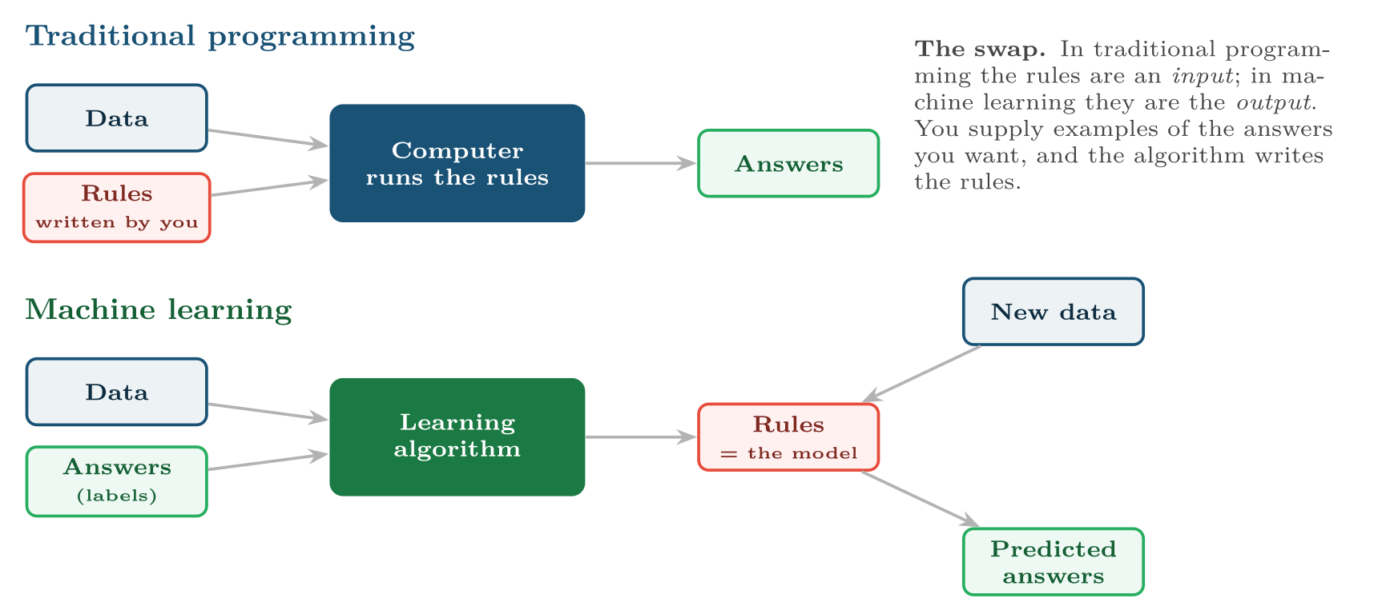
Traditional programming against machine learning
FIGURE 1.1
The learned model is then used exactly like a program: new data in, answers out.
Machine Learning · Chapter 1 · What Machine Learning Is
§1.1 · Handout p. 3 7
Notes:
Suppose you are asked to write a program that flags phishing e-mails. You could sit down and write rules: if the sender’s domain does not match the display name, and the message contains a link, and it mentions a password, flag it. The first version catches some phishing. Then the attackers read your rules — or simply vary their wording — and the rules stop working. You add more. After a year you have four hundred rules that contradict one another, nobody understands, and that still miss the attack that arrived this morning. Now suppose instead that you collect fifty thousand e-mails that people have already marked as phishing or legitimate, and hand them to a program whose job is to find the rules. When the attackers change tactics, you do not rewrite anything: you collect new examples and let the program find new rules. That is the whole idea of machine learning, and Figure 1.1 shows it in one picture.
Figure 1.1 (handout p. 4): Traditional programming against machine learning. The learned model is then used exactly like a program: new data in, answers out.

Slide 8

When Learning Beats Writing
CONCEPT
Machine learning earns its cost in four situations: when the rules are too numerous to write (recognising handwriting); when nobody can articulate them (judging whether a machine sounds unhealthy); when they change faster than a person can rewrite them (phishing, fraud); and when they must be different for every user (recommendations). If you can write the rule down in an afternoon and it will not change, write it — a rule is cheaper, faster and easier to explain than any model.
Machine Learning · Chapter 1 · What Machine Learning Is
§1.1 · Handout p. 3 8
Notes:
Read the box aloud, then ask for an example from the room before moving on.

Slide 9
A Precise Definition
SECTION 2 OF 7
1.2
1.1 Why Learn a Program Instead of Writing One?
1.2 A Precise Definition
1.3 The Four Paradigms
1.4 Designing a Learning System
1.5 Learning as Search Through a Hypothesis Space
1.6 A Short History
1.7 Where Machine Learning Sits
Machine Learning · Chapter 1
Handout §1.2 9
Notes:
Pause. Name the question this section answers.

Slide 10

Machine Learning (Mitchell, 1997)
DEFINITION
A computer program is said to learn from experience E with respect to some class of tasks T and performance measure P, if its performance at tasks in T, as measured by P, improves with experience E.
Machine Learning · Chapter 1 · What Machine Learning Is
§1.2 · Handout p. 4 10
Notes:
The definition used throughout this course is Tom Mitchell’s, from the set text. It is worth memorising because it forces you to say exactly what you mean before you start.

Slide 11

Naming T, P and E
WORKED EXAMPLE
State the task, performance measure and experience for three problems.
1. Phishing filter.
• T: classify each incoming e-mail as phishing or legitimate.
• P: the fraction of phishing e-mails caught, subject to fewer than one legitimate e-mail in a thousand being blocked.
• E: a corpus of e-mails already labelled by users and analysts.
2. Sprint effort estimation.
• T: predict the hours a user story will take.
• P: average absolute error, in hours, on stories not yet estimated.
• E: past stories with their descriptions, story points and actual hours.
Machine Learning · Chapter 1 · What Machine Learning Is
§1.2 · Handout p. 4 11
Notes:
The three letters are not decoration. A project that cannot name its P cannot tell whether it is making progress; a project that cannot name its E does not know what data to collect. Most failed machine learning projects failed here, before any algorithm was chosen.
Each click adds one step of the working. Ask for the next number before you reveal it.

Slide 12
Naming T, P and E (continued)
WORKED EXAMPLE
3. A robot learning to balance.
• T: choose motor commands that keep the robot upright.
• P: average time before it falls.
• E: the robot’s own attempts — no labelled examples at all, only the consequences of what it tried.
Notice the choice of P in problem 1. “Accuracy” would have been the obvious answer and the wrong one: if 2% of e-mail is phishing, a filter that lets everything through is 98% accurate. Choosing P is a design decision with consequences, and Chapter 8 is devoted to it.
Machine Learning · Chapter 1 · What Machine Learning Is
§1.2 · Handout p. 4 12
Notes:
Each click adds one step of the working. Ask for the next number before you reveal it.

Slide 13
The Four Paradigms
SECTION 3 OF 7
1.3
1.1 Why Learn a Program Instead of Writing One?
1.2 A Precise Definition
1.3 The Four Paradigms
1.4 Designing a Learning System
1.5 Learning as Search Through a Hypothesis Space
1.6 A Short History
1.7 Where Machine Learning Sits
Machine Learning · Chapter 1
Handout §1.3 13
Notes:
Pause. Name the question this section answers.

Slide 14
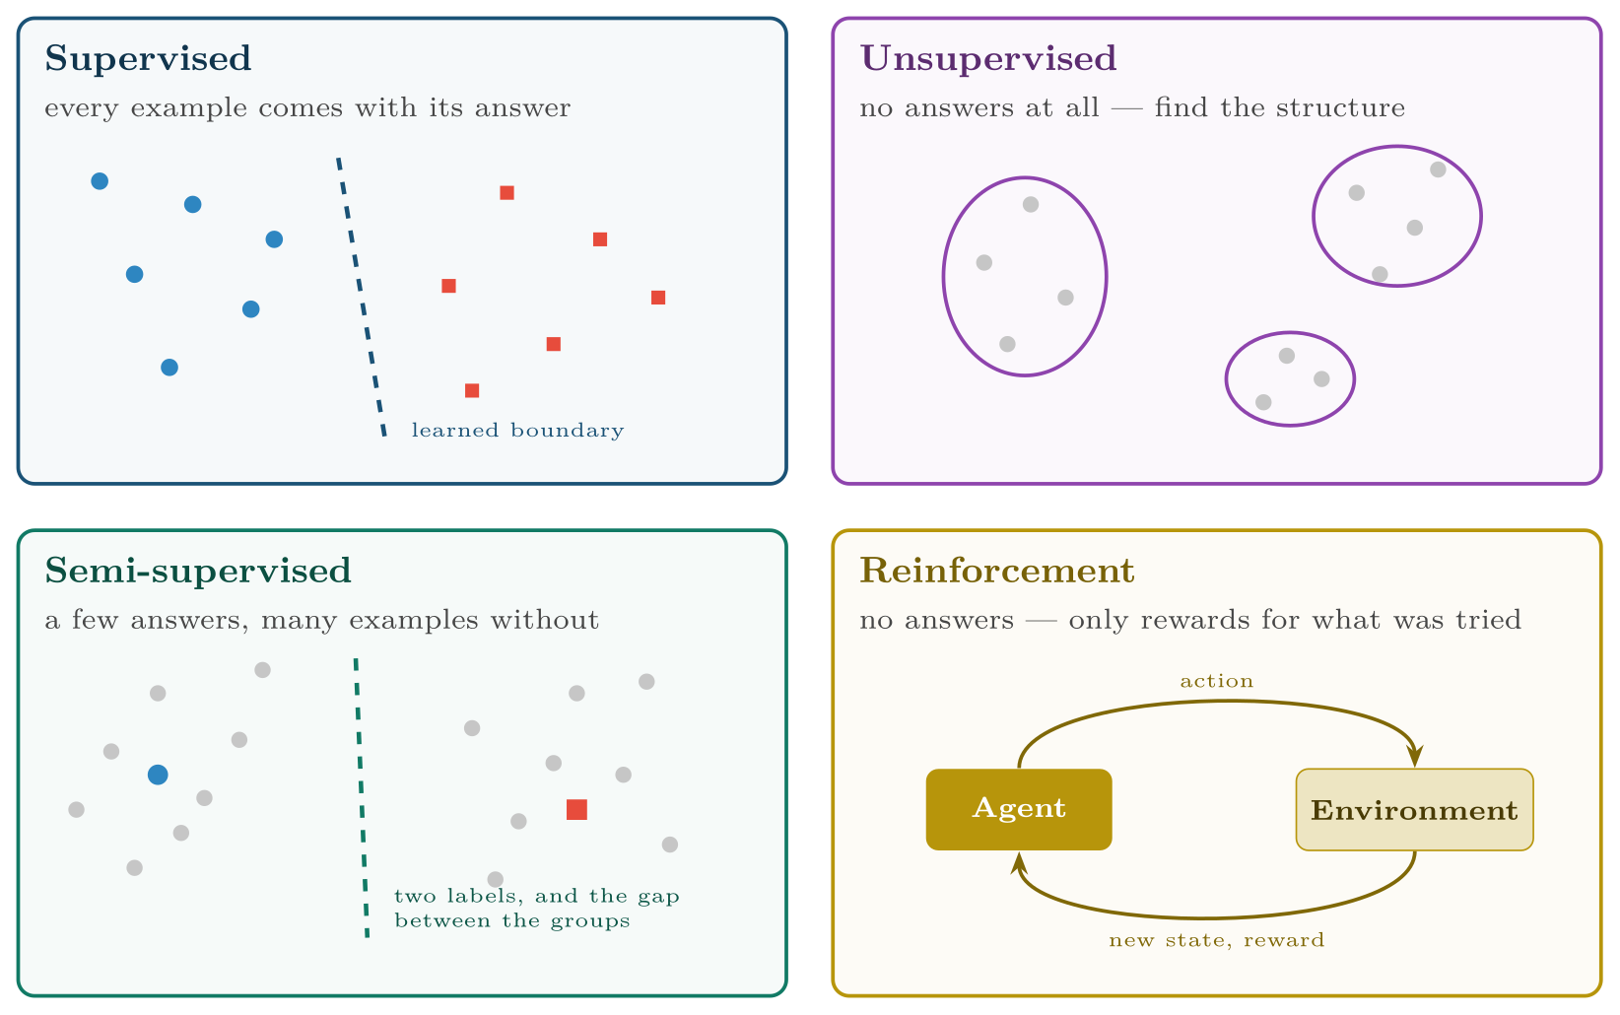
The Four Paradigms
FIGURE 1.2
The four paradigms, distinguished by what the experience tells the learner about the right answer: all of it, none of it, a little of it, or only whether what it did turned out well.
Machine Learning · Chapter 1 · What Machine Learning Is
§1.3 · Handout p. 5 14
Notes:
What varies most between learning problems is the experience — in particular, what the data tells you about the right answer. That gives four paradigms, sketched in Figure 1.2.
Figure 1.2 (handout p. 5): The four paradigms, distinguished by what the experience tells the learner about the right answer: all of it, none of it, a little of it, or only whether what it did turned out well.

Slide 15
The Four Paradigms
DEFINITION
Supervised learning: every training example is a pair (x, y) of features and the correct answer (label). If y is a category the task is classification; if y is a number it is regression.
Unsupervised learning: examples x with no labels. The task is to find structure — groups, directions of variation, a compact representation.
Semi-supervised learning: a few labelled examples and many unlabelled ones, used together.
Reinforcement learning: an agent acts in an environment and receives a reward. Nobody says what the right action was; the agent must discover which actions lead, eventually, to high reward.
Machine Learning · Chapter 1 · What Machine Learning Is
§1.3 · Handout p. 5 15
Notes:
Read the box aloud, then ask for an example from the room before moving on.

Slide 16

The Four Paradigms
AT A GLANCE
Paradigm | Experience | Learns | Example | Chapters
Supervised, regression | Features and a numeric target | A function to a number | Hours a user story will take | 5, 7, 11, 13, 14
Supervised, classification | Features and a category | A function to a class | Phishing or legitimate | 6, 8–14
Unsupervised | Features only | Groups, directions, maps | Kinds of network traffic | 15, 16
Semi-supervised | Few labels, many unlabelled | A classifier using both | Malware families from a handful of analysed samples | 17
Reinforcement | States, actions, rewards | A policy: what to do in each state | A thermostat learning to save energy | 19, 20
Machine Learning · Chapter 1 · What Machine Learning Is
§1.3 · Handout p. 5 16
Notes:
Do not read the table row by row: pick the row the room is most likely to get wrong and ask why.

Slide 17

Classification or Regression? Look at the Target, Not the Features
WATCH OUT
The paradigm is decided by what y is. “Predict a student’s final mark” is regression; “predict whether the student will pass” is classification — same students, same features, different y. Numbers used as category codes (port 22, grade 3 on a 1–5 scale) are a common trap: ask whether averaging two values of y would mean anything.
Machine Learning · Chapter 1 · What Machine Learning Is
§1.3 · Handout p. 5 17
Notes:
Read the box aloud, then ask for an example from the room before moving on.

Slide 18
The Four Design Decisions
WORKED EXAMPLE
1. Choose the training experience. Records of past students with their Week 4 data and their final result. Is it representative? Only if past cohorts resemble this one — a change of syllabus or of intake breaks that.
2. Choose the target function. What exactly should be learned?
• Option A: V: student → {pass, fail}.
• Option B: V: student → [0,1], the probability of failing.
Option B is more useful: it lets staff call the riskiest students first.
3. Choose a representation for the approximation V̂ of the target. For example, a weighted sum of features:
Machine Learning · Chapter 1 · What Machine Learning Is
§1.4 · Handout p. 6 18
Notes:
Mitchell’s set text frames the construction of any learner as four decisions, made in order. They are shown here for a problem this course returns to repeatedly: predicting in Week 4 which students will fail a course.
Each click adds one step of the working. Ask for the next number before you reveal it.

Slide 19
The Four Design Decisions (continued)
WORKED EXAMPLE
where σ squashes any number into [0,1] (Chapter 6). Choosing this form rules out, for good or ill, every pattern it cannot express.
4. Choose a learning algorithm that sets the weights w₀, …, w₃ from the training experience — here, gradient descent on a loss (Chapter 2).
The first three decisions matter more than the fourth. A poor choice of experience or target cannot be rescued by a better algorithm.
Machine Learning · Chapter 1 · What Machine Learning Is
§1.4 · Handout p. 6 19
Notes:
Each click adds one step of the working. Ask for the next number before you reveal it.

Slide 20
Learning as Search Through a Hypothesis Space
SECTION 5 OF 7
1.5
1.1 Why Learn a Program Instead of Writing One?
1.2 A Precise Definition
1.3 The Four Paradigms
1.4 Designing a Learning System
1.5 Learning as Search Through a Hypothesis Space
1.6 A Short History
1.7 Where Machine Learning Sits
Machine Learning · Chapter 1
Handout §1.5 20
Notes:
Pause. Name the question this section answers.

Slide 21
Hypothesis and Hypothesis Space
DEFINITION
A hypothesis h is one candidate function from inputs to outputs — one particular setting of the weights, one particular decision tree. The hypothesis space H is the set of all hypotheses the representation allows. The unknown true function the data came from is the target function c (or f). Learning is a search through H for a hypothesis that agrees with c — not just on the training data, but on data not yet seen.
Machine Learning · Chapter 1 · What Machine Learning Is
§1.5 · Handout p. 7 21
Notes:
Decision 3 deserves a closer look. Once you fix a representation, you have fixed the set of all functions the learner could possibly produce.

Slide 22
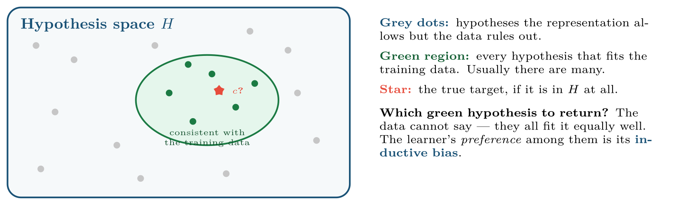
Learning as search
FIGURE 1.3
The data narrows the hypothesis space to those hypotheses consistent with it; something other than the data must choose among the survivors.
Machine Learning · Chapter 1 · What Machine Learning Is
§1.5 · Handout p. 7 22
Notes:
Figure 1.3 (handout p. 7): Learning as search. The data narrows the hypothesis space to those hypotheses consistent with it; something other than the data must choose among the survivors.

Slide 23
Why a Learner Must Assume Something
CONCEPT
Show a learner the examples (1 → 2), (2 → 4), (3 → 6) and ask for the output at 4. “8” is the natural answer, but the function that returns 2x for x ≤ 3 and 0 otherwise fits the three examples just as perfectly. Nothing in the data prefers one to the other. You prefer 2x because you assume the simpler pattern continues. That assumption — the inductive bias — is not a defect to be removed: a learner with no bias at all cannot generalise beyond the examples it has seen. Chapter 4 proves this, and every later chapter names the bias of its algorithm.
Machine Learning · Chapter 1 · What Machine Learning Is
§1.5 · Handout p. 7 23
Notes:
Read the box aloud, then ask for an example from the room before moving on.

Slide 24
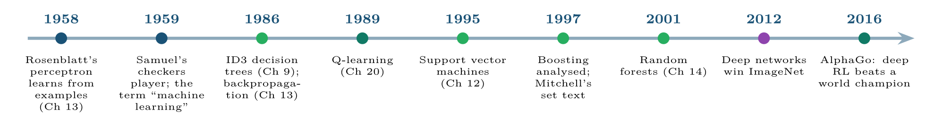
Selected milestones
FIGURE 1.4
Most of what this course teaches was in place by 2001; what changed after 2012 was mainly scale — data, computation, and the depth of the networks.
Machine Learning · Chapter 1 · What Machine Learning Is
§1.6 · Handout p. 7 24
Notes:
Figure 1.4 (handout p. 7): Selected milestones. Most of what this course teaches was in place by 2001; what changed after 2012 was mainly scale — data, computation, and the depth of the networks.

Slide 25

Common pitfalls
COMMON PITFALLS
✕
Choosing the algorithm first. “Let’s use a neural network” before T, P and E are written down. Decide what success means, and what data exists, before anything else.
✕
Judging a model on the data it learned from. Any sufficiently flexible model can memorise its training data. Performance means performance on examples it has not seen (Chapter 7).
✕
Treating a category code as a number. Port 443 is not “more” than port 80; averaging them means nothing.
✕
Believing unsupervised means objective. Every clustering reflects choices — of features, distance and number of groups — made by a person (Chapter 15).
✕
Calling any automation “machine learning”. A threshold written by a person is a rule, not a model, however useful it is.
Machine Learning · Chapter 1 · What Machine Learning Is
§1.7 · Handout p. 8 25
Notes:
The ideas in this course are older than most students expect. Frank Rosenblatt’s perceptron learned from examples in 1958; Arthur Samuel’s checkers program, which improved by playing against itself, gave the field its name in 1959. Decision trees, backpropagation, reinforcement learning, support vector machines and ensembles were all in place by 2001. What changed after 2012 was mostly scale — data, computing power, and the depth of the neural networks that both made practical. That is why a course built on a 1997 set text is not out of date: the deep learning course that follows this one is built on exactly these foundations.

Slide 26





Four lenses: Framing a Learning Problem
FOUR LENSES
LEARNING ANALYTICS
PROJECT MANAGEMENT
T: rank this term’s students by risk of failing.
T: predict the actual hours for a user story.
INTERNET OF THINGS
CYBERSECURITY
T: classify one second of motor vibration as healthy or failing.
T: classify each network connection as benign or malicious.
Machine Learning · Chapter 1 · What Machine Learning Is
Handout p. 10 26
Notes:
The same method, four domains. Each of the next four slides opens one lens in full.

Slide 27

Learning Analytics: Framing a Learning Problem
FOUR LENSES
LEARNING ANALYTICS
Project Management
T: rank this term’s students by risk of failing. P: of the students who go on to fail, the fraction in the top 20% of the ranking. E: three past cohorts with their Week 4 records. The trap is E: a model trained on cohorts who received no intervention learns a world that the intervention itself will change.
Internet of Things
Cybersecurity
Machine Learning · Chapter 1 · What Machine Learning Is
Handout p. 10 27
Notes:
Learning Analytics. T: rank this term’s students by risk of failing. P: of the students who go on to fail, the fraction in the top 20% of the ranking. E: three past cohorts with their Week 4 records. The trap is E: a model trained on cohorts who received no intervention learns a world that the intervention itself will change.

Slide 28

Project Management: Framing a Learning Problem
FOUR LENSES
PROJECT MANAGEMENT
Learning Analytics
T: predict the actual hours for a user story. P: mean absolute error in hours. E: the team’s completed stories. The trap is volume — a single team completes perhaps two hundred stories a year, which is small data, and the estimates the team gave were themselves influenced by earlier predictions.
Internet of Things
Cybersecurity
Machine Learning · Chapter 1 · What Machine Learning Is
Handout p. 10 28
Notes:
Project Management. T: predict the actual hours for a user story. P: mean absolute error in hours. E: the team’s completed stories. The trap is volume — a single team completes perhaps two hundred stories a year, which is small data, and the estimates the team gave were themselves influenced by earlier predictions.

Slide 29

Internet of Things: Framing a Learning Problem
FOUR LENSES
INTERNET OF THINGS
Learning Analytics
T: classify one second of motor vibration as healthy or failing. P: failures caught at least a day before breakdown, with at most one false alarm per machine per month. E: vibration logs joined to maintenance records. The trap is that failures are rare, so there may be only a dozen labelled failures in years of data.
Project Management
Cybersecurity
Machine Learning · Chapter 1 · What Machine Learning Is
Handout p. 10 29
Notes:
Internet of Things. T: classify one second of motor vibration as healthy or failing. P: failures caught at least a day before breakdown, with at most one false alarm per machine per month. E: vibration logs joined to maintenance records. The trap is that failures are rare, so there may be only a dozen labelled failures in years of data.

Slide 30

Cybersecurity: Framing a Learning Problem
FOUR LENSES
CYBERSECURITY
Learning Analytics
T: classify each network connection as benign or malicious. P: detection rate at a fixed, tolerable number of alerts per analyst per hour. E: labelled traffic from past incidents. The trap is the adversary: E describes last year’s attacks, and the attacker’s whole aim is for this year’s not to resemble them.
Project Management
Internet of Things
Machine Learning · Chapter 1 · What Machine Learning Is
Handout p. 10 30
Notes:
Cybersecurity. T: classify each network connection as benign or malicious. P: detection rate at a fixed, tolerable number of alerts per analyst per hour. E: labelled traffic from past incidents. The trap is the adversary: E describes last year’s attacks, and the attacker’s whole aim is for this year’s not to resemble them.

Slide 31

Try it yourself: A Rule Against a Learned Model
TRY IT YOURSELF
Write a rule by hand, then let an algorithm learn one, and compare them on data neither has seen. The Wisconsin breast cancer data ships with scikit-learn: 569 tumours, 30 measurements each, labelled malignant or benign.
WHAT YOU WILL DO
1. A rule written by a person: large tumours are malignant
2. A rule found by a learning algorithm
3. The baseline every result must beat
THIS WEEK'S LAB
WHAT YOU WILL RUN
RUNNABLE COPY
Week 1: A rule against a learned model; the chapter in NumPy
1 listing, 22 lines of Python
code/ch01_rule_against_learned.py
Machine Learning · Chapter 1 · What Machine Learning Is
§1.7 · Handout p. 8 31
Notes:
Write a rule by hand, then let an algorithm learn one, and compare them on data neither has seen. The Wisconsin breast cancer data ships with scikit-learn: 569 tumours, 30 measurements each, labelled malignant or benign.

Slide 32
A Rule Against a Learned Model
LAB · STEP 1 OF 4
Set-up
Python · code/ch01_rule_against_learned.py
2
3
4
5
6
7
8
9
10
from sklearn.datasets import load_breast_cancer
from sklearn.model_selection import train_test_split
from sklearn.tree import DecisionTreeClassifier
from sklearn.metrics import accuracy_score
data = load_breast_cancer()
X, y = data.data, data.target # y: 0 = malignant, 1 = benign
X_tr, X_te, y_tr, y_te = train_test_split(
X, y, test_size=0.25, random_state=0, stratify=y)
Machine Learning · Chapter 1 · What Machine Learning Is
§1.7 · Handout p. 8 32
Notes:
Step 1: Set-up. Read the code aloud; ask what each line would print before running it.

Slide 33
A Rule Against a Learned Model
LAB · STEP 2 OF 4
A rule written by a person: large tumours are malignant
Python · code/ch01_rule_against_learned.py
12
13
14
15
# --- 1. a rule written by a person: large tumours are malignant ---------
radius = list(data.feature_names).index("mean radius")
rule = (X_te[:, radius] < 15).astype(int) # small -> benign (1)
print("hand-written rule :", accuracy_score(y_te, rule))
Machine Learning · Chapter 1 · What Machine Learning Is
§1.7 · Handout p. 8 33
Notes:
Step 2: A rule written by a person: large tumours are malignant. Read the code aloud; ask what each line would print before running it.

Slide 34
A Rule Against a Learned Model
LAB · STEP 3 OF 4
A rule found by a learning algorithm
Python · code/ch01_rule_against_learned.py
17
18
19
# --- 2. a rule found by a learning algorithm ----------------------------
tree = DecisionTreeClassifier(max_depth=3, random_state=0).fit(X_tr, y_tr)
print("learned tree :", accuracy_score(y_te, tree.predict(X_te)))
Machine Learning · Chapter 1 · What Machine Learning Is
§1.7 · Handout p. 8 34
Notes:
Step 3: A rule found by a learning algorithm. Read the code aloud; ask what each line would print before running it.

Slide 35
A Rule Against a Learned Model
LAB · STEP 4 OF 4
The baseline every result must beat
Python · code/ch01_rule_against_learned.py
21
22
23
# --- 3. the baseline every result must beat -----------------------------
majority = int(y_tr.mean() > 0.5)
print("always 'majority' :", accuracy_score(y_te, [majority] * len(y_te)))
Machine Learning · Chapter 1 · What Machine Learning Is
§1.7 · Handout p. 8 35
Notes:
Step 4: The baseline every result must beat. Read the code aloud; ask what each line would print before running it.

Slide 36
What the lab shows
TRY IT YOURSELF
Then change the threshold 15 in the hand-written rule, and the depth 3 of the tree, and watch both numbers. Which one is easier to improve by hand?
Machine Learning · Chapter 1 · What Machine Learning Is
§1.7 · Handout p. 8 36
Notes:
Read the box aloud, then ask for an example from the room before moving on.

Slide 37

A thermostat switches on the heating whenever the temperature drops below a value the owner set. Is this machine learning? Use the definition.
CHECKPOINT 1 OF 3
Discuss with the person next to you, then advance.
Machine Learning · Chapter 1 · What Machine Learning Is
Handout p. 10 · answers in Appendix D 37
Notes:
Ask the room. Do not advance until someone commits to an answer.

Slide 38

A thermostat switches on the heating whenever the temperature drops below a value the owner set. Is this machine learning? Use the definition.
CHECKPOINT 1 OF 3 · ANSWER
No. The rule was written by the owner and the thermostat’s performance does not improve with experience: there is no E. It is automation, not learning.
Machine Learning · Chapter 1 · What Machine Learning Is
Handout p. 10 · answers in Appendix D 38
Notes:
Answer (Appendix D): No. The rule was written by the owner and the thermostat’s performance does not improve with experience: there is no E. It is automation, not learning.

Slide 39
Classify each as regression, classification, clustering or reinforcement learning: (a) predicting tomorrow’s server load in requests per second; (b) grouping customers with no labels; (c) deciding whether a login is fraudulent; (d) a program learning to play a video game from its score.
CHECKPOINT 2 OF 3
Discuss with the person next to you, then advance.
Machine Learning · Chapter 1 · What Machine Learning Is
Handout p. 10 · answers in Appendix D 39
Notes:
Ask the room. Do not advance until someone commits to an answer.

Slide 40
Classify each as regression, classification, clustering or reinforcement learning: (a) predicting tomorrow’s server load in requests per second; (b) grouping customers with no labels; (c) deciding whether a login is fraudulent; (d) a program learning to play a video game from its score.
CHECKPOINT 2 OF 3 · ANSWER
(a) regression; (b) clustering (unsupervised); (c) classification; (d) reinforcement learning.
Machine Learning · Chapter 1 · What Machine Learning Is
Handout p. 10 · answers in Appendix D 40
Notes:
Answer (Appendix D): (a) regression; (b) clustering (unsupervised); (c) classification; (d) reinforcement learning.

Slide 41
Why can a learner with no inductive bias not classify an example it has never seen?
CHECKPOINT 3 OF 3
Discuss with the person next to you, then advance.
Machine Learning · Chapter 1 · What Machine Learning Is
Handout p. 10 · answers in Appendix D 41
Notes:
Ask the room. Do not advance until someone commits to an answer.

Slide 42
Why can a learner with no inductive bias not classify an example it has never seen?
CHECKPOINT 3 OF 3 · ANSWER
Because for any unseen instance, every hypothesis consistent with the data that calls it positive has a twin, equally consistent, that calls it negative. The data says nothing about unseen instances; only an assumption — a bias — can.
Machine Learning · Chapter 1 · What Machine Learning Is
Handout p. 10 · answers in Appendix D 42
Notes:
Answer (Appendix D): Because for any unseen instance, every hypothesis consistent with the data that calls it positive has a twin, equally consistent, that calls it negative. The data says nothing about unseen instances; only an assumption — a bias — can.

Slide 43

What to take away
CHAPTER SUMMARY
1
Machine learning reverses traditional programming: you supply examples of the answers and the algorithm produces the rules.
2
A program learns if its performance P at task T improves with experience E. Name all three before choosing an algorithm.
3
The paradigm is set by the experience: labelled (supervised), unlabelled (unsupervised), partly labelled (semi-supervised) or rewarded (reinforcement). Regression and classification differ only in y.
4
Designing a learner means choosing the experience, the target function, its representation and a learning algorithm — in that order of importance.
5
Learning is search through a hypothesis space. The data narrows it; the inductive bias chooses among what is left, and without one no generalisation is possible.
Machine Learning · Chapter 1 · What Machine Learning Is
Handout p. 10 43
Notes:
Ask the room to say each takeaway before you reveal it.

Slide 44

Quick check 1 of 3
REVIEW · MULTIPLE CHOICE
Predicting the number of help-desk tickets tomorrow is:
A
classification
B
regression
C
clustering
D
reinforcement learning
Machine Learning · Chapter 1 · What Machine Learning Is
Handout p. 10 44
Notes:
Take a show of hands for each option before discussing. (The handout does not print MCQ answers.)

Slide 45
Quick check 2 of 3
REVIEW · MULTIPLE CHOICE
In Mitchell’s definition, E stands for:
A
error
B
experience
C
expectation
D
evaluation
Machine Learning · Chapter 1 · What Machine Learning Is
Handout p. 10 45
Notes:
Take a show of hands for each option before discussing. (The handout does not print MCQ answers.)

Slide 46
Quick check 3 of 3
REVIEW · MULTIPLE CHOICE
A dataset of 10,000 photographs of which 200 are labelled suits:
A
supervised
B
unsupervised
C
semi-supervised
D
reinforcement learning
Machine Learning · Chapter 1 · What Machine Learning Is
Handout p. 10 46
Notes:
Take a show of hands for each option before discussing. (The handout does not print MCQ answers.)

Slide 47
For your notebook
REVIEW QUESTIONS
SHORT
Give one problem for which you would write rules rather than learn a model, and explain why.
SHORT
Explain, with an example, the difference between the target function and a hypothesis.
SHORT
Why is “accuracy” often the wrong performance measure? Give a numeric example.
APPLIED
A university wants to recommend elective courses to students. Specify T, P and E; state which paradigm applies; and describe the four design decisions you would make.
APPLIED
For the phishing filter in the first worked example, describe what could make the training experience unrepresentative of the e-mail the filter will face next year, and what you would do about it.
Machine Learning · Chapter 1 · What Machine Learning Is
Handout p. 10 47
Notes:
Set these for independent study. Model answers are not printed in the handout.

Slide 48

Where Machine Learning Sits
KEY IDEA
In the Artificial Intelligence course you built agents that search, reason and plan using knowledge someone supplied. Machine learning is the part of AI in which the knowledge is acquired from data instead. Deep learning is, in turn, the part of machine learning that uses neural networks with many layers. A chess engine searching with a hand-written evaluation function is AI but not ML; the same engine with an evaluation function learned from games is both.
Machine Learning · Chapter 1 · What Machine Learning Is
§1.7 · Handout p. 8 48
Notes:
Say this in your own words first; the slide is the handout's wording.

Slide 49
End of Chapter 1
01
NEXT
READ
Chapter 2 — Mathematics for Machine Learning
Handout Chapter 1, pages 3–10
THIS WEEK'S LAB
A rule against a learned model; the chapter in NumPy
Machine Learning · Chapter 1 · What Machine Learning Is
49
Notes:
Close. NEXT: Chapter 2 — Mathematics for Machine Learning. READ: Handout Chapter 1, pages 3–10. THIS WEEK'S LAB: A rule against a learned model; the chapter in NumPy.

